Slide 1
Food blog
NEVER EVER WITHOUT FOOD

Slide 2

ABSTRACT
This project is a precursor for a potential food ordering site.
The concept that has been attempted to be highlighted through this project is the importance of recognizing the indigenous cuisine of the country.
The project showcases only indigenous foods as the choices available to the user at present.
The system also has an in-built billing option that the user will be navigated to on clicking the image of any item.

Slide 3

INTRODUCTION
Most restaurants are not interested in the rich indigenous cuisine.
The mission behind undertaking this project was restoring the awe that the food of this soil has been invoking .
By creating a model that could potentially pave way for an e-commerce site that serves people their own cuisine.

Slide 4

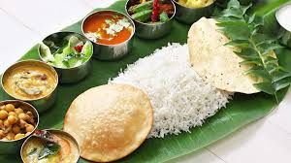
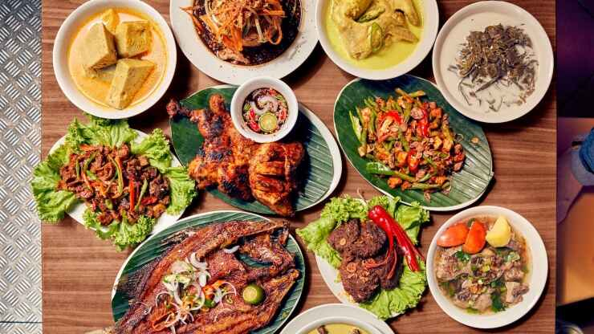
OBJECTIVES
Reviving people’s interest in Indian cuisine.
Creating a model for a prospective e-commerce site.
Exploring the different ways to monetize the site.

Slide 5

TECHNIQUE USED
Food Blog webpage was laid down by the following properties:
Table properties of html
Font properties
List properties under navigation bar
Header properties
Image properties
Properties of input elements
Button properties
Alert functions & other javascript functions.

Slide 6

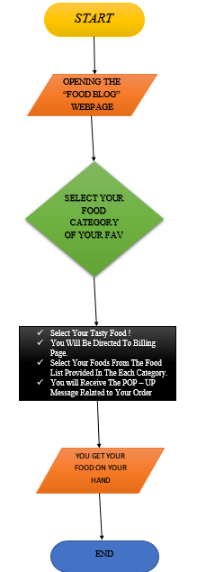
FLOW CHART FOR THE SITE PROCESS

Slide 7

SOFTWARE & HARDWARE REQUIREMENTS
Internet explorer of versions 6
Firefox browser of version 3.5
Opera browser of version 2
Chrome version 8 or more

Slide 8

ADVANTAGES
Availability of our indigenous
User’s comfort.
Clear diverse menu of food
Accommodate huge amount of orders

Slide 9

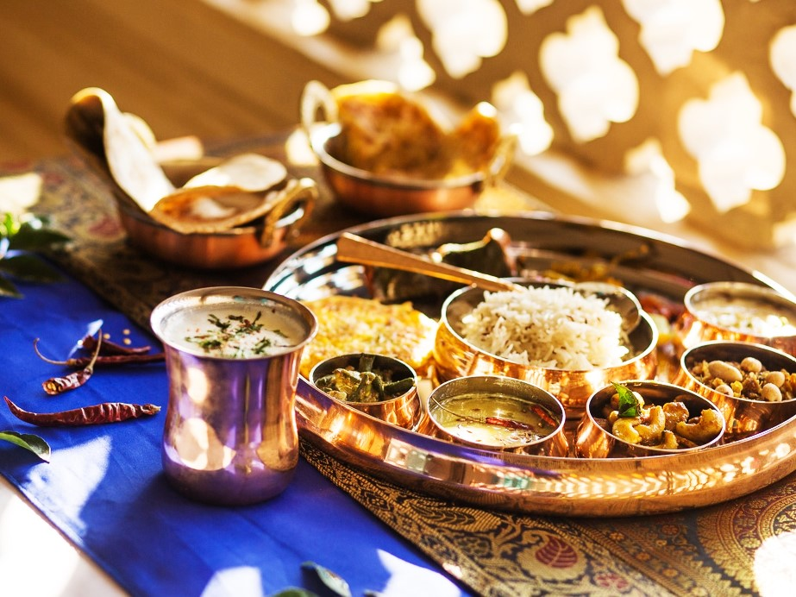
OUR FOOD CATEGORY
Tiffin
Rice & Meals
Traditional Foods
Dry Items
Gravy & Curry

Slide 10
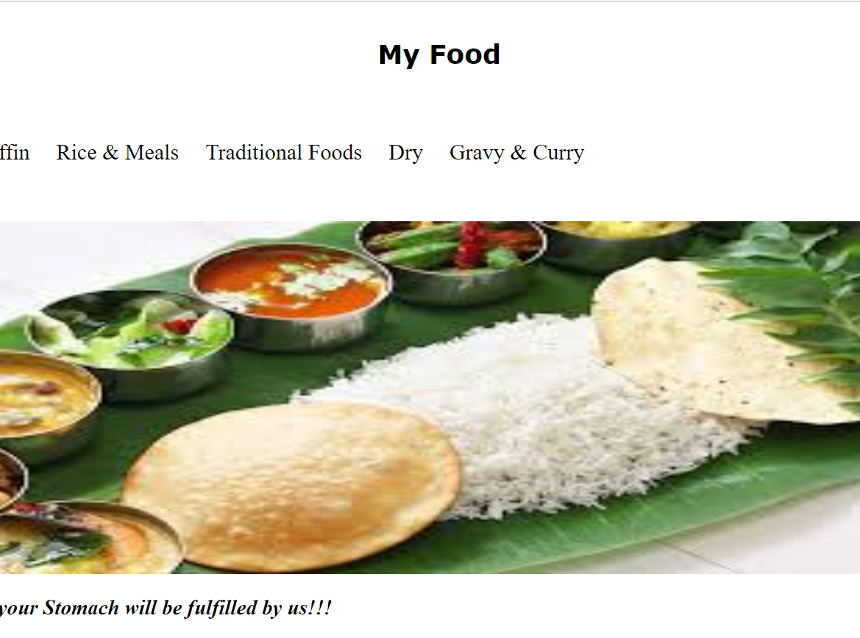
HOME PAGE

Slide 11
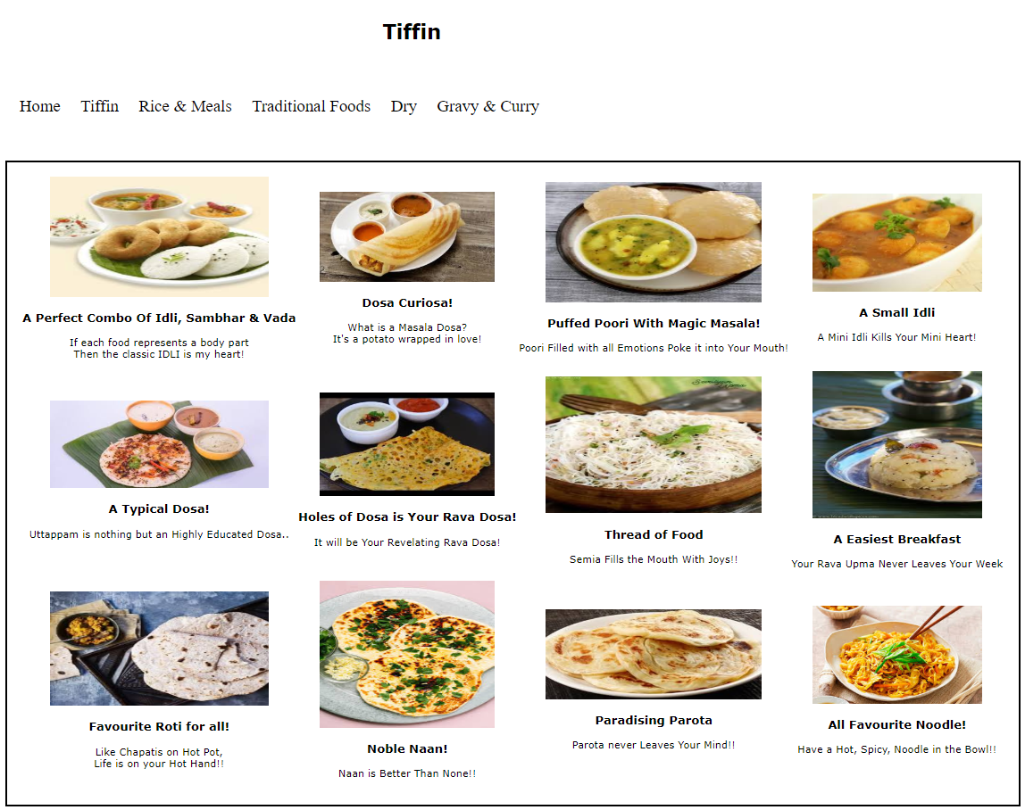
TIFFIN

Slide 12
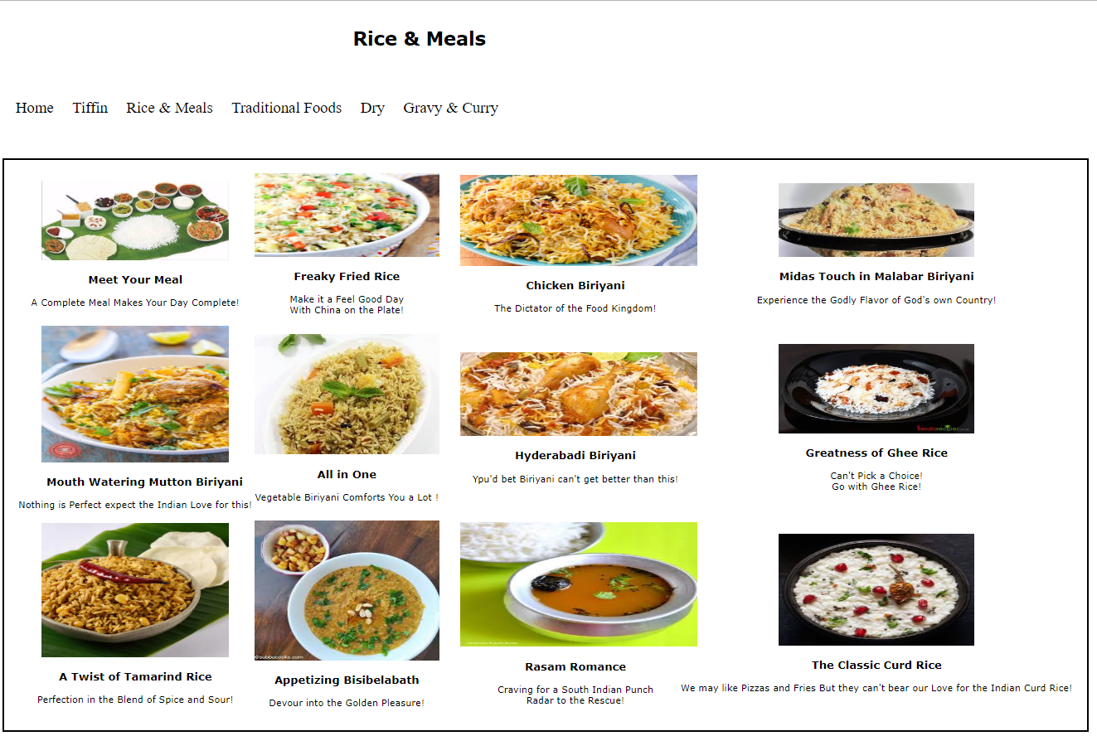
RICE AND MEALS

Slide 13
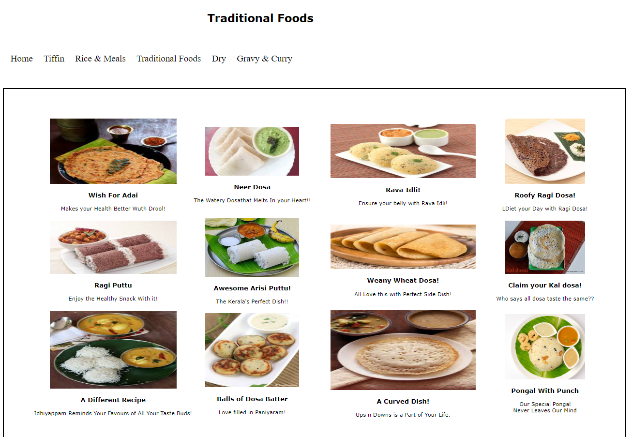
TRADITIONAL FOODS

Slide 14
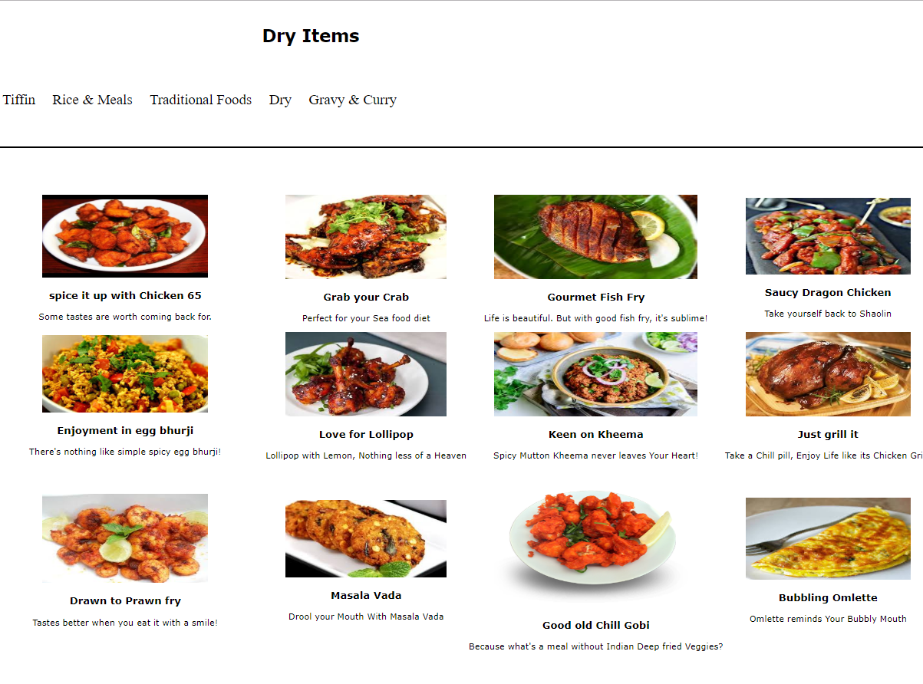
DRY ITEMS

Slide 15
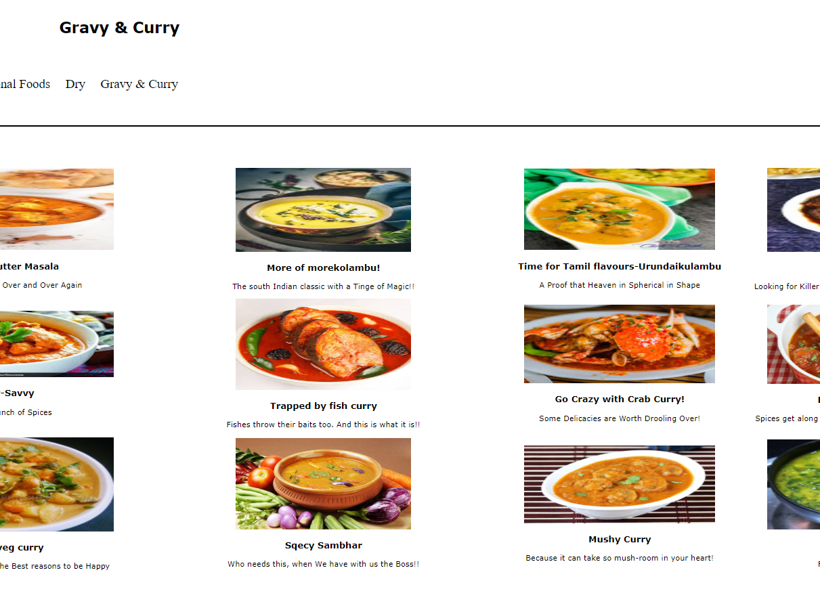
GRAVY & CURRY

Slide 16
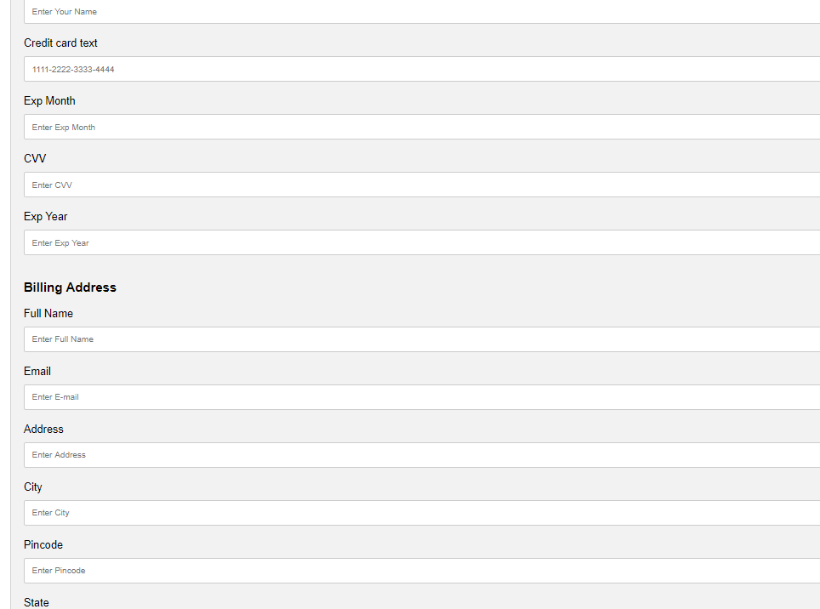
BILLING PAGE

Slide 17

CONCLUSION
Thus, this is a model that is flexible enough to be open to changes and yet cling on to its founding principle of promoting indigenous cuisine of the country.
The site stands representing a single place or restaurant in its incubation model and it intends to remain so amidst all the planned improvements to the site.
The site will not be opened to other restaurants as a common platform like the other popular contemporary e-commerce site.
The site will be maintained in terms of its ease of usage with utmost focus.

Slide 18

FUTURE ENCHANCEMENT
Monetize the site.
Linking the site to a functional restaurant
Taking a commission for every order
Allowing restaurants to place advertisements
Coupons and discounts.

Slide 19

REFERENCE
Online food ordering practices
https://en.wikipedia.org/wiki/Online_food_ordering
Online billing system guidelines
https://www.avidxchange.com/what-is-electronic-billing/
Ecommerce guidelines of India
https://consumeraffairs.nic.in/sites/default/files/file-uploads/latestnews/Guidelines
Food ordering site creation
https://www.spaceotechnologies.com/create-online-food-ordering-system-guide/

Slide 20
THANK YOU

